Slide 1

Slide 1
DATA MINING

Slide 2



Slide 10
TEAM MEMBERS
GROUP - 04
INTRODUCTION
Our dataset comprises details With a mix of numerical and categorical features, the dataset lends itself to analysis for uncovering patterns and relationships, allowing exploration of factors like RAM-price correlation, touchscreen prevalence, and the distribution of laptops across types and brands.
AADESH NAIK - #R01583319 ROHIT DHANESHWAR - #R01582617 SAISH BHARMAL - #R01583659 NIHAR MORA - #R01583850
Our analyses offer a comprehensive understanding of the dataset, equipping us to draw meaningful conclusions and informed insights. Utilizing linear regression models, we establish a predictive framework for 'Price,' while clustering techniques help reveal distinct patterns and groupings within the dataset. These findings enhance the foundation for further exploration and informed decision-making in our domain.

Slide 3
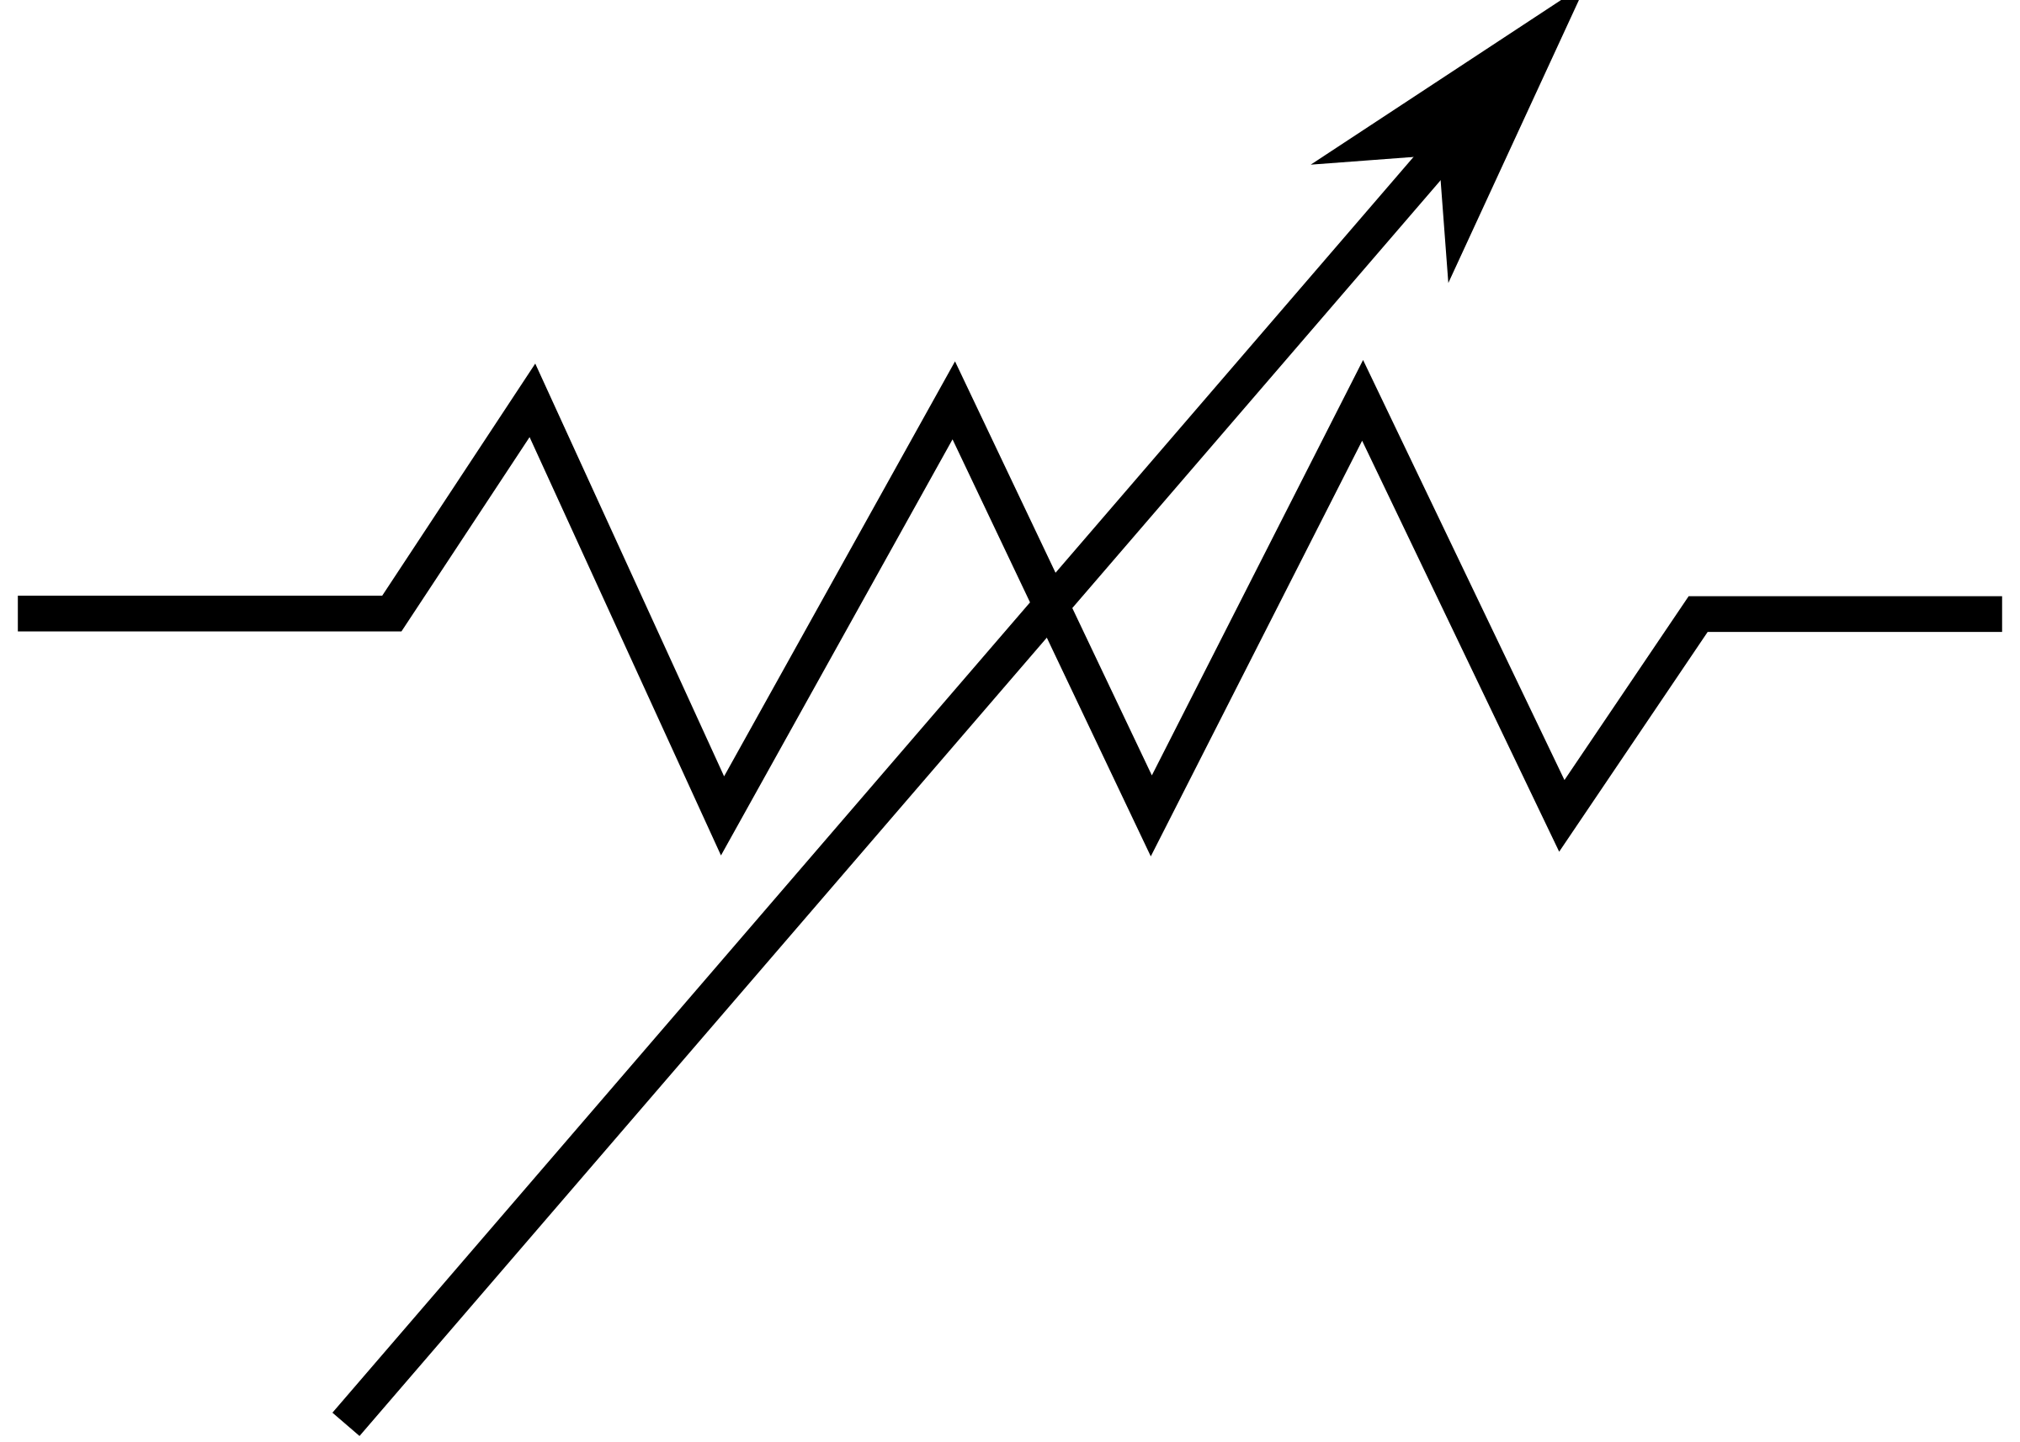
Slide 4
PROBLEM AND DATA COLLECTION
PROBLEM: Predicting laptop prices relies on scrutinizing specifications like processor speed, graphics, and storage. Machine learning models can decipher patterns in these specs and historical pricing for accurate predictions. Simultaneously, customer segmentation based on RAM and SSD preferences allows targeted marketing. For instance, those prioritizing multitasking may opt for higher RAM, while storage-intensive users may favor larger SSDs. This segmentation helps manufacturers tailor products and strategies to meet diverse consumer needs, enhancing market competitiveness. DATA COLLECTION: Dataset comes from Kaggle.com

Slide 4

Slide 9
PROJECT TIMELINE
EDA MODEL
CLUSTER MODEL
CONCLUSION
LINEAR REGRESSION MODEL
ANALYSIS APPROACH

Slide 5

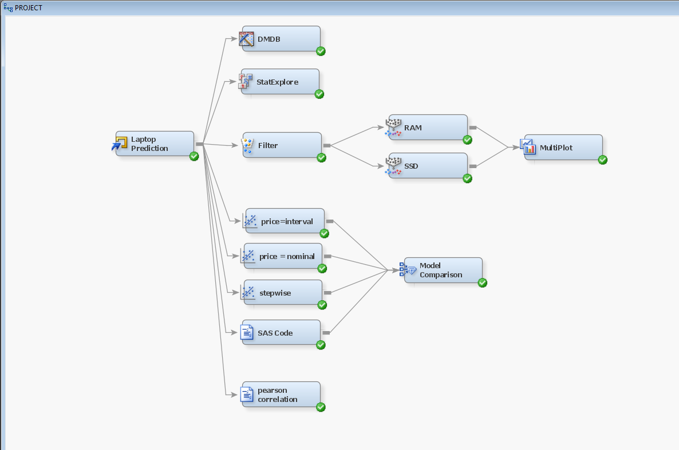
Slide 4
SAS MODEL

Slide 6
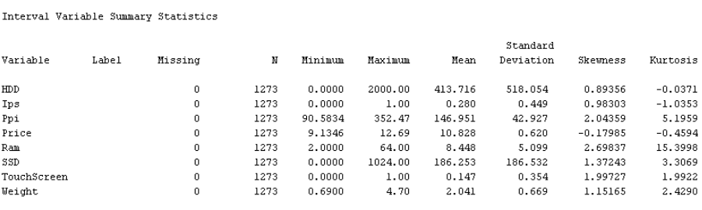
Slide 2
EDA
After a comprehensive analysis and exploratory data examination (EDA), we have confirmed the absence of any missing values in the dataset. This ensures that the data is ready for further analysis and interpretation.

Slide 7
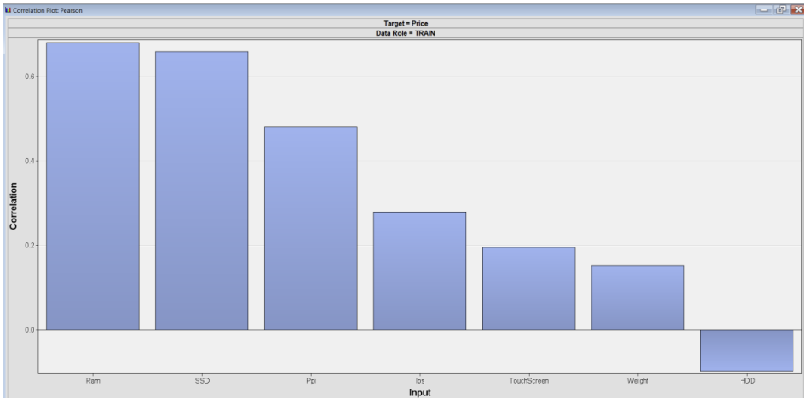
Slide 4
DATA DRIVEN
STATEXPLORE
This correlation plot illustrates the relationship between price and various variables, highlighting the presence of collinearity.
The data reveals that RAM exhibits the highest variation, suggesting a direct correlation with pricing.
As the RAM increases, the pricing also shows a corresponding increase.

Slide 8
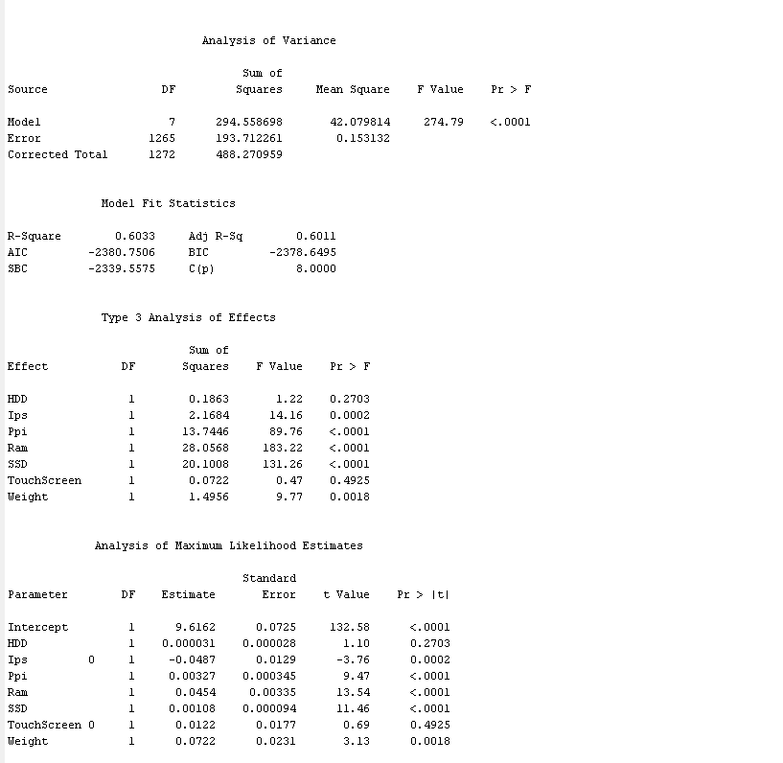
Slide 4
Linear Regression
BY TAKING INTERVAL INPUT
THE VAIRANCE
The elevated F-value indicates a substantial difference among the compared groups, while the low p-value suggests a reduced likelihood of the observed distinctions occurring by chance.
60%

Slide 9
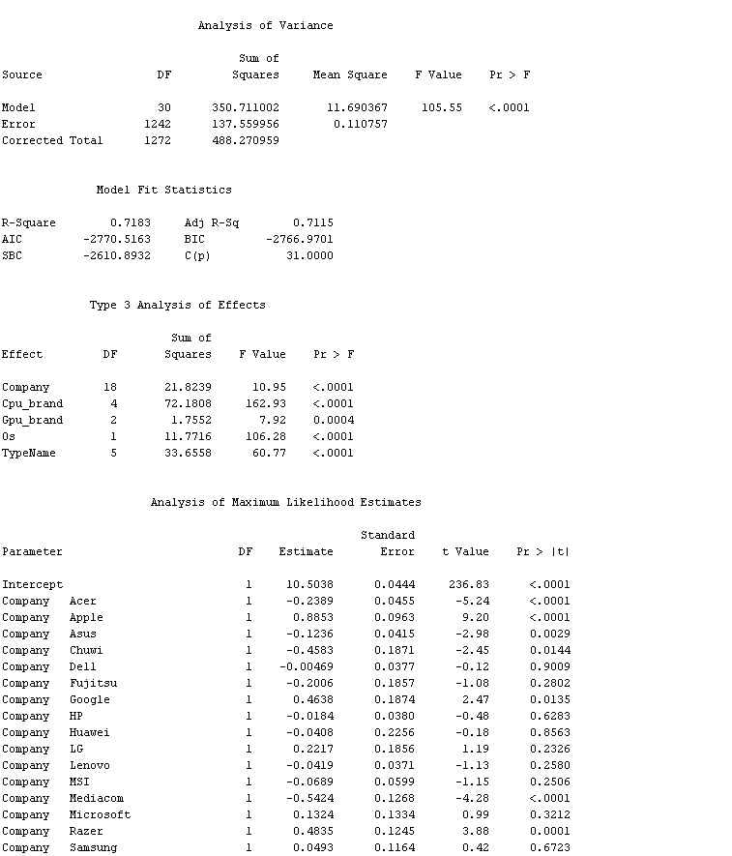
Slide 4
Linear Regression
BY TAKING NOMINAL INPUTS
THE VAIRANCE
The elevated F-value indicates a moderate among the compared groups, while the low p-value suggests a reduced likelihood of the observed distinctions occurring by chance.
71%

Slide 10
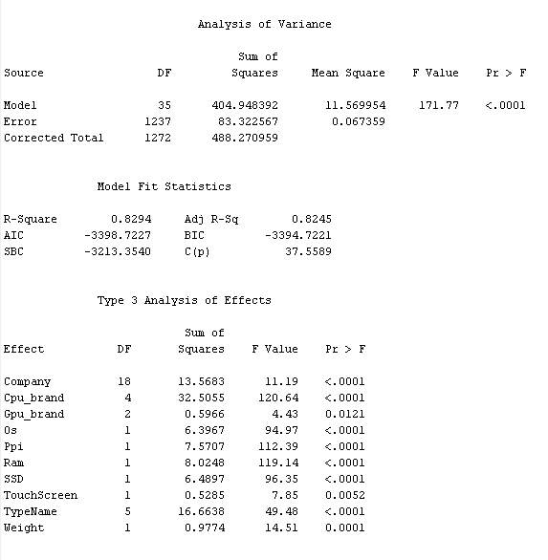
Slide 4
Linear Regression
BY STEPWISE
THE VAIRANCE
R2 =0.8294, which is quite high. This suggests that approximately 82.94% of the variance in the dependent variable is explained by the independent variable(s) in your linear regression model. In other words, the model fits the data well and captures a significant portion of the variability in the target variable.
82%

Slide 11
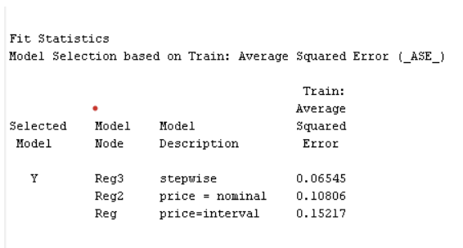
Slide 4
Linear Regression
Model comparison
After model comparison stepwise model has the lowest average square error so we choose stepwise for better predictive performance.

Slide 12
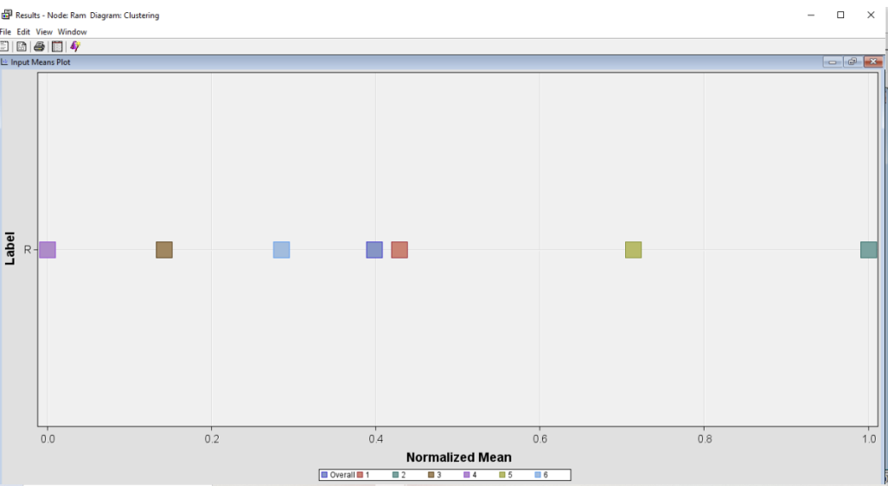
Slide 6
CLUSTER ANALYSIS
INPUT MEAN PLOT FOR RAM

Slide 13
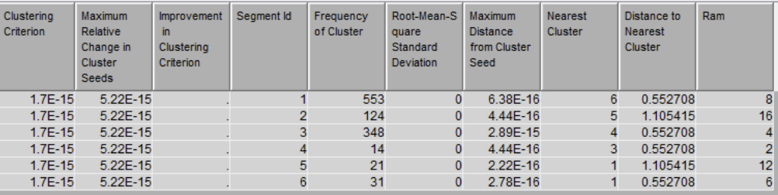
Slide 6
CLUSTER ANALYSIS
MEAN STATISTIC
Clusters based on RAM usage reveal the following patterns
The most prevalent cluster is associated with customers using 8 GB RAM.
Conversely, the least common cluster pertains to customers utilizing 2 GB RAM.

Slide 14
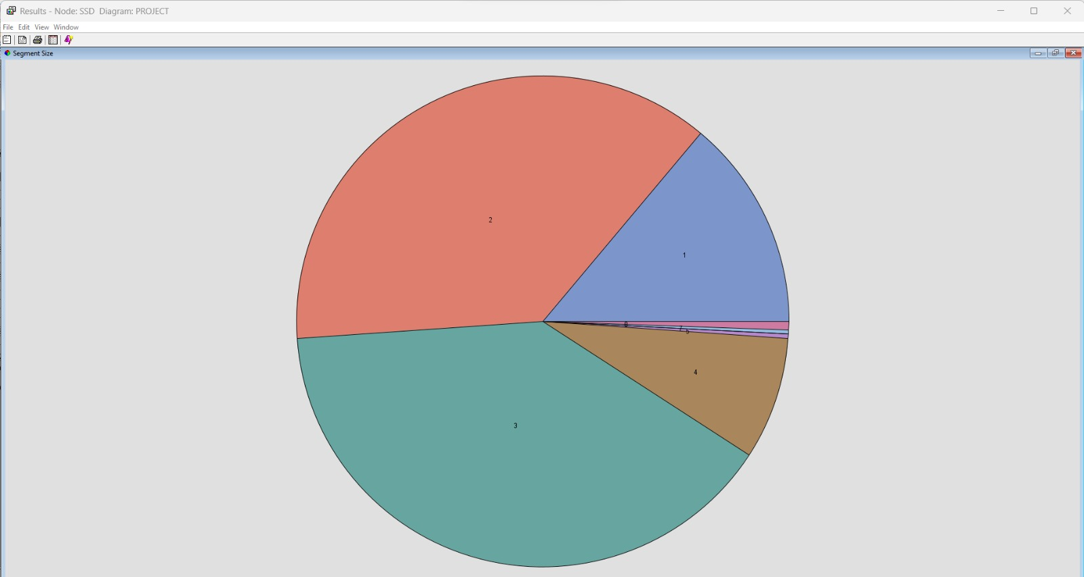
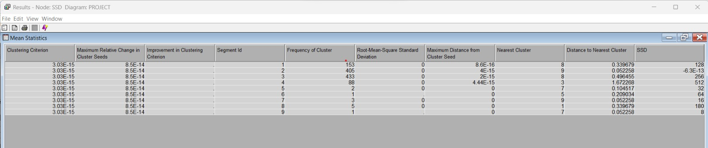
Slide 6
CLUSTER ANALYSIS
SEGMENT SIZE OF CLUSTER ON SSD
SEGMENT SIZE OF CLUSTER ON SSD
MEAN STATISTIC ON SSD

Slide 15
Slide 4
CONCLUSION
Through rigorous analysis, our predictive model underscores the significance of RAM, PPI, and SSD as crucial factors in predicting laptop prices.
Enhanced RAM facilitates superior multitasking, elevated PPI contributes to improved display quality, and SSDs boost storage speed.
Laptops with superior specifications in these areas command higher prices, aligning with market trends that prioritize optimal computing capabilities and an enriched user experience.

Slide 16

Slide 3
ANALYSIS APPROACH
e
EDA
LINEAR REGRESSION
Conducted exploratory data analysis (EDA) to assess the relationship and potential impact of input features on the predictive model concerning the target variable.
Through multiple linear regression, we pinpoint vital predictors for the target variable by assessing relationships among independent variables, bolstering the creation of a robust predictive model.
80%
CLUSTER
Conducted RAM-based clustering to identify customer segments with varying RAM capacities, highlighting both high and low user groups. Additionally, applied clustering to the SSD variable for categorizing customers based on SSD specifications, offering insights for strategic decision-making.

Slide 17

Slide 11
THANK YOU!

